Slide 1


An Autonomous Institute
Affiliated to VTU, Belagavi,
Approved by AICTE, New Delhi,
Recognized by UGC with 2(f) & 12(B)
Accredited by NBA & NAAC
“Image recognition of Devanagiri script using CNN”
N TEJESWAR REDDY 1MJ22CD036
SELVKARTHIK S 1MJ22CD047
M T VINAY 1MJ22CD027
RAKESH KUMAR PANDEY 1MJ22CD043
Prof. Rekha P, Assistant HOD, Department of Data Science
An Autonomous Institution ,Affiliated to Visvesvaraya Technological University, Belagavi. Approved By AICTE, New Delhi. Recognized by UGC with 2(f) & 12(B) status. Accredited by NBA and NAAC.

Slide 2
CONTENTS
Abstract
Introduction
Literature Survey
Existing System and Proposed System
Data-flow Diagrams
Algorithms Used
Implementation Code
System Requirements Specification
Modules Identified

Slide 3
ABSTRACT
This project explores the application of Convolutional Neural Networks (CNNs) for the image recognition of Devanagari script, a widely used writing system in languages such as Hindi, Marathi, and Sanskrit. The primary objective is to develop a robust model capable of accurately identifying and classifying characters from images of handwritten and printed Devanagari text. The project begins with the collection and preprocessing of a diverse dataset comprising various styles and sizes of Devanagari characters to ensure the model's generalizability. We employ a CNN architecture, leveraging its hierarchical feature extraction capabilities to capture the intricate patterns and structures inherent in the script. The model is trained and validated using accuracy to assess its effectiveness. Additionally, we implement data augmentation techniques to enhance the model's robustness against variations in character representation. The results demonstrate a significant improvement in recognition accuracy compared to traditional methods, highlighting the potential of deep learning approaches in optical character recognition (OCR) tasks. This project not only contributes to the field of automated text recognition but also facilitates the digitization and accessibility of Devanagari script in various applications, including educational tools and language processing system.

Slide 4
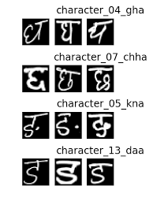
INTRODUCTION
Handwriting identification is one of the challenging research domains in computer vision. the handwritten recognition in non-English is difficult due to complex shapes. Many Indian Languages like Hindi, Sanskrit, Nepali, Marathi, Sindhi, and Konkani uses Devanagari script.
Recognition of Devanagari is particularly challenging due to many groups of similar characters. For example, Figure shows similarity is visible between character 04 and character 07, also between character 05 and character 13. Several researchers have proposed handcrafted features for recognition of strokes. Building a robust set of features for Devanagari is challenging due to the complex shape of characters.
In recent years, Deep Learning has gained popularity in computer vision and pattern recognition primarily due to Deep Convolution Neural Network (DCNN).
In this paper, we present Transfer learning, which is a deep learning technique that uses a pre-developed model for a task as a starting point.

Slide 5
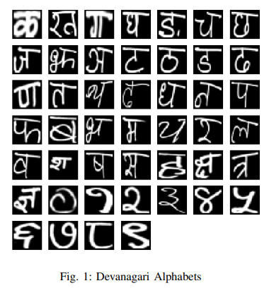
. The alphabets of Devanagari Handwritten Character Dataset (DHCD) is shown in below Figure.

Slide 6
LITERATURE SURVEY
Author / Year of Publish | Title
Nagender Aneja∗ and Sandhya Aneja ∗ ∗Universiti Brunei Darussalam Brunei Darussalam | Transfer Learning using CNN for Handwritten Devanagari Character Recognition
Prafulla E Ajmire and Shankar Eknath Warkhede. 2018 | An Analytical Study of Devanagari Script Recognition.
Holambe A.N. *, Thool R.C. , Shinde U.B. and Holambe S.N.4 2010 | Brief review of research on Devanagari script

Slide 7
LITERATURE SURVEY
Author / Year of Publish | Title
Prathiba Singh and Narendra Chaudhari 2015 | On the performance Improvement of Devanagiri Handwritten character recognition.
Kannuru Padmaja 2022 | Devanagiri Handwritten Character Recognition Using Deep learning.
Rahul S Narsing 2022 | Devanagiri Character Recognition using Image Processing and Machine learning.

Slide 8
Existing System and Proposed System
Existing System:
HARIPERISETLA/DEVANAGARI-HANDWRITTEN-CHARACTER-RECOGNITION-CNN: This project utilizes CNN for recognizing Devanagari handwritten characters.
A RECOGNITION SYSTEM FOR DEVANAGARI HANDWRITTEN DIGITS: Developed by Nawaraj Ghimire, this system focuses on recognizing handwritten digits in the Devanagari script.
Proposed System:
Display the words present in the image after processing unlike the existing system which shows only the accuracy of image processing.

Slide 9
System Requirements Specification
Software Tools:
Programming language: python
Deep learning: CNN
VS code: for code development
Hardware Tools:
Processor: intel i3/i5/i7
RAM: minimum 4GB

Slide 10
MODULES IDENTIFIED
Handwritten Characters
Decoding the Dataset
Preprocessing
Hyperparameter tuning
Training the model
Evaluating the model

Slide 11
Algorithm Used:
CNN
A Convolutional Neural Network (CNN) is a type of deep learning model specifically designed for processing structured grid data, such as images.
model = models.Sequential()
model.add(layers.Conv2D(32, (3, 3), activation='relu', input_shape=x_train.shape[1:]))
model.add(layers.MaxPooling2D((2, 2)))
model.add(layers.Conv2D(64, (3, 3), activation='relu'))
model.add(layers.MaxPooling2D((2, 2)))
model.add(layers.Conv2D(128, (3, 3), activation='relu'))
model.add(layers.MaxPooling2D((2, 2)))
model.add(layers.Flatten())
model.add(layers.Dense(128, activation='relu'))
model.add(layers.Dense(num_classes, activation='softmax'))

Slide 12
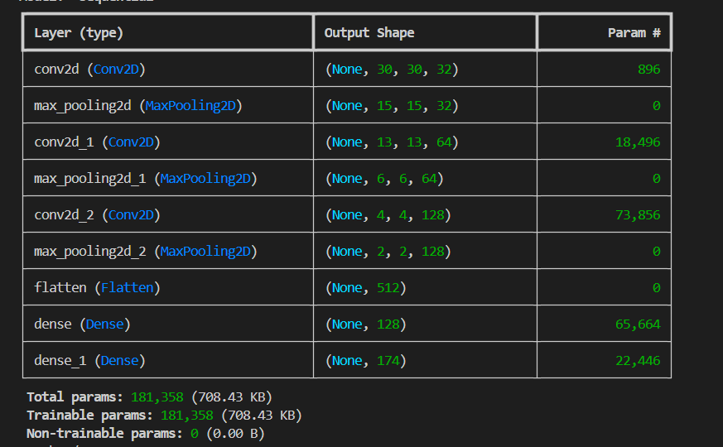
CNN

Slide 13
HYPERPARAMETER TUNING
from kerastuner import Hyperbanddef build_model(hp): model=models.Sequential() model.add(layers.Conv2D(filters=hp.Choice('conv_1_filter',values=[32,64,128]),kernel_size=hp.Choice('conv_1_kernel',values=[3,5]),activation='relu',input_shape=x_train.shape[1:])) model.add(layers.MaxPooling2D((2,2))) model.add(layers.Conv2D(filters=hp.Choice('conv_2_filter',values=[32,64,128]),kernel_size=hp.Choice('conv_2_kernel',values=[3,5]),activation='relu')) model.add(layers.MaxPooling2D((2,2))) model.add(layers.Dropout(hp.Choice('dropout_rate',values=[0.2,0.3,0.5]))) model.add(layers.Flatten()) model.add(layers.Dense(units=hp.Choice('dense_units',values=[128,256,512]),activation='relu')) model.add(layers.Dense(num_classes,activation='softmax')) model.compile(optimizer=hp.Choice('optimizer',values=['adam','sgd']),loss='categorical_crossentropy',metrics=['accuracy']) return model

Slide 14
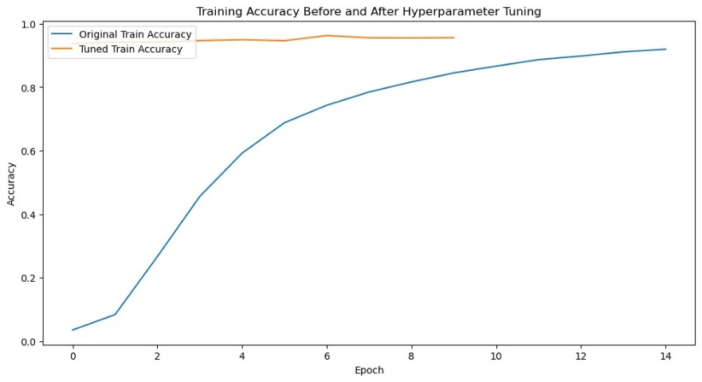
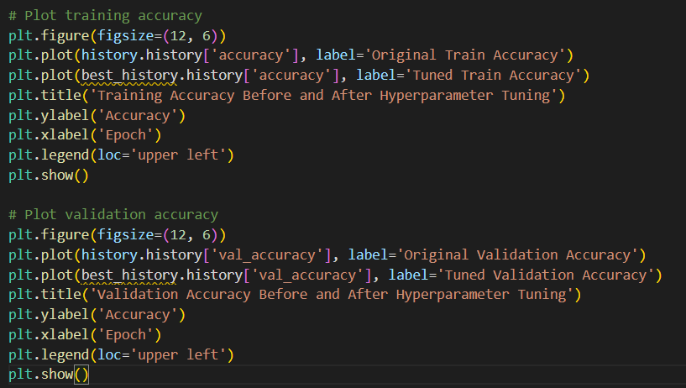
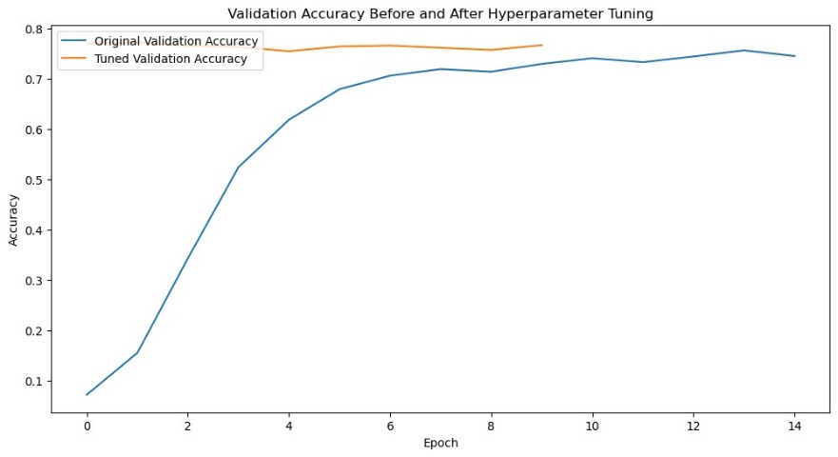
HYPERPARAMETER TUNING

Slide 15
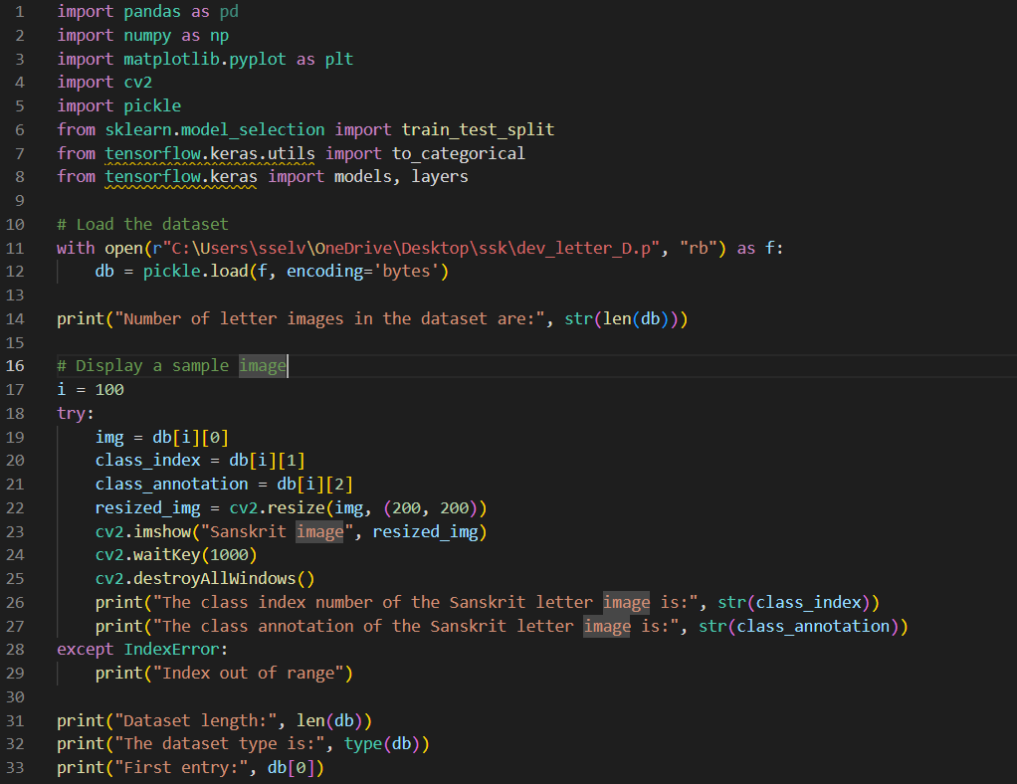
Implementation Code Text Summary:

Slide 16
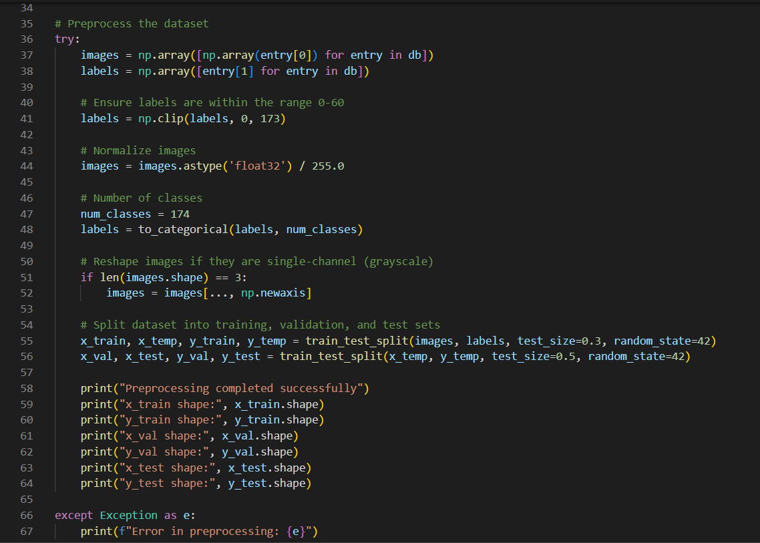

Slide 17
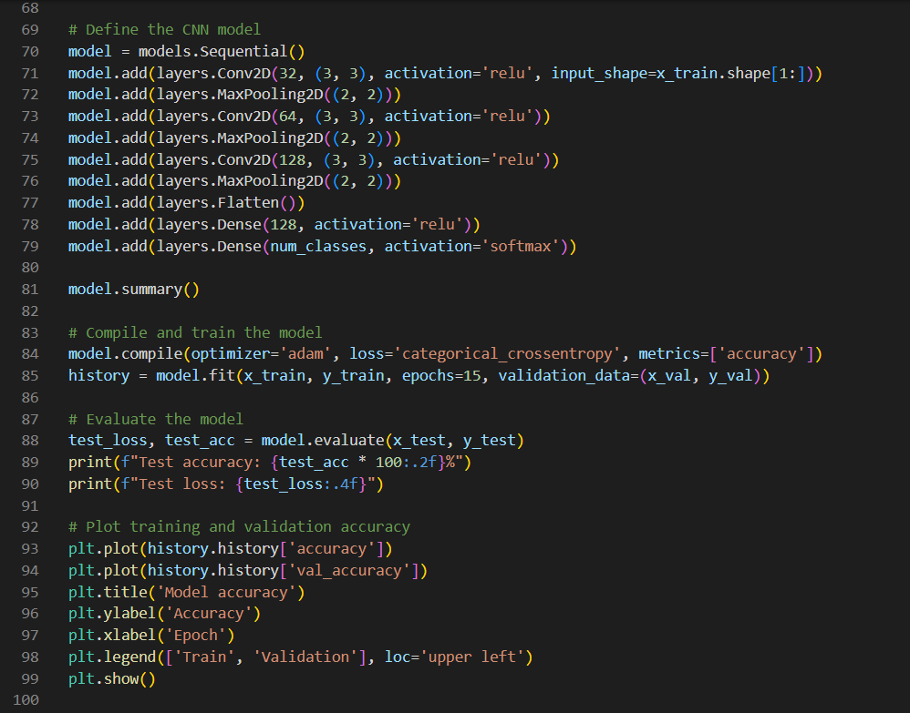
Implementation Code

Slide 18
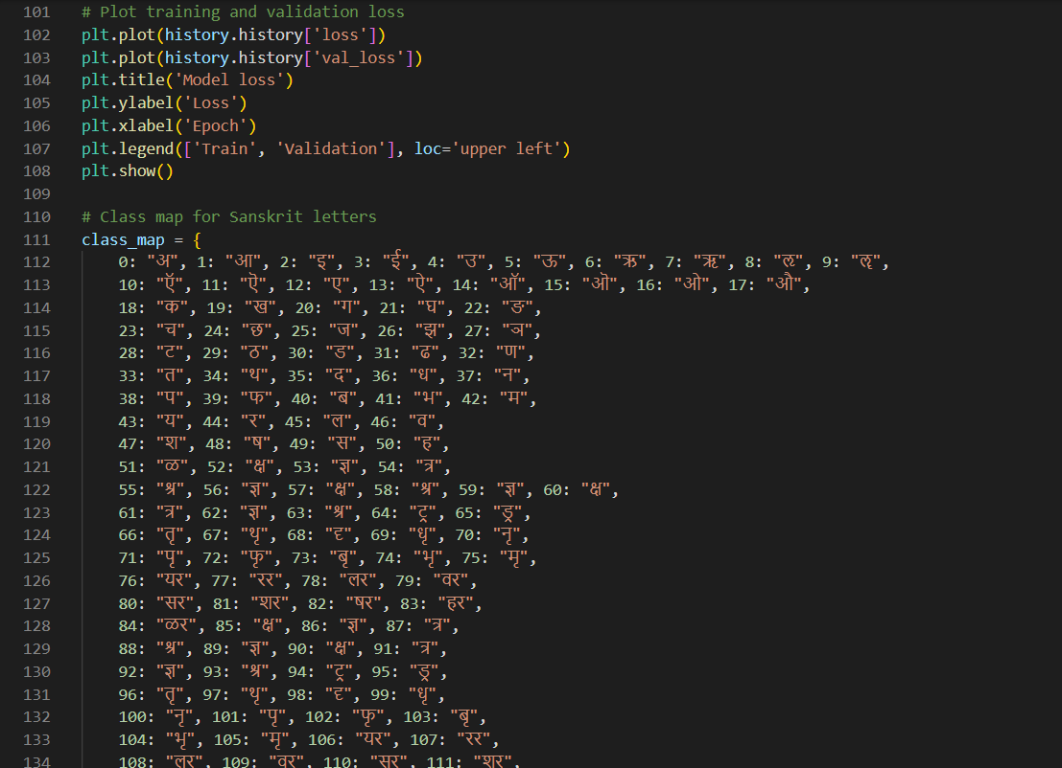
Implementation Code

Slide 19
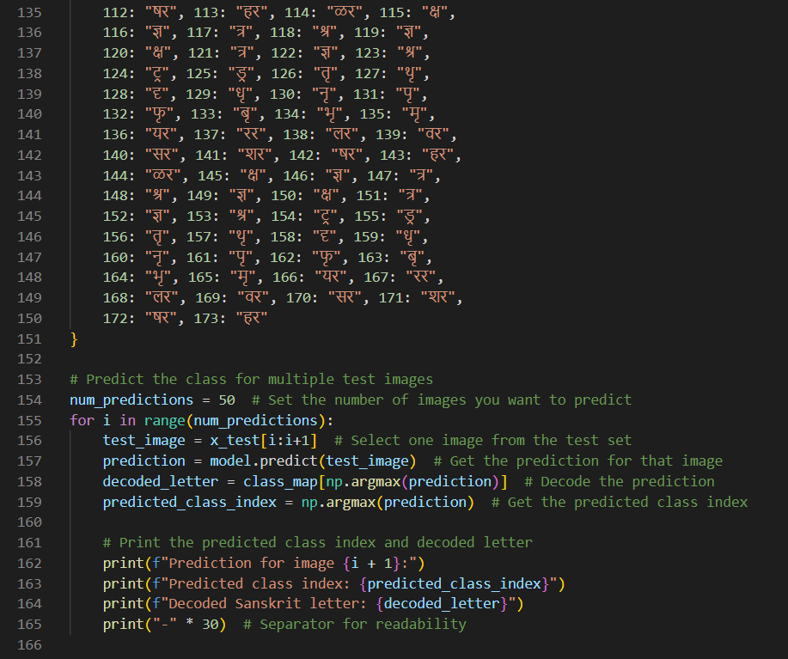
Implementation Code

Slide 20
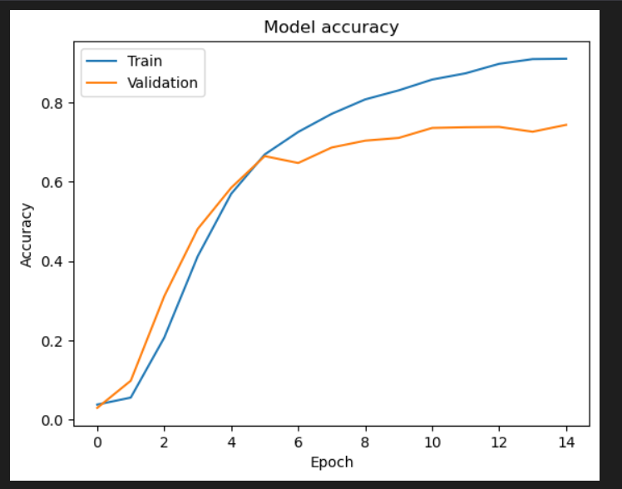
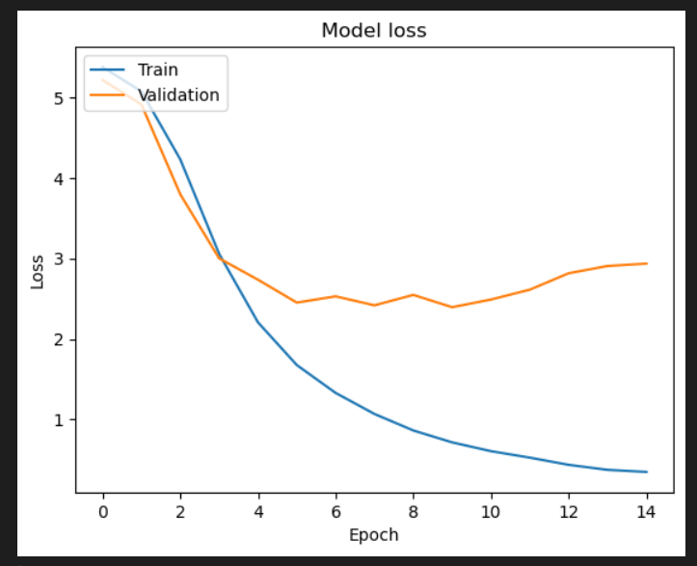
Outcomes:

Slide 21
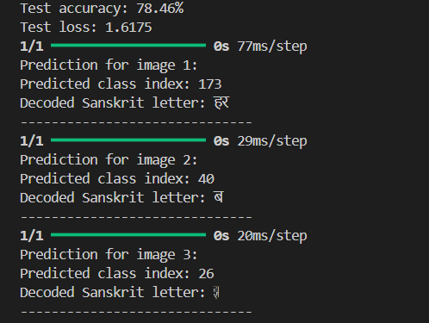
Outcomes:

Slide 22
Conclusion
In conclusion, our project on Devanagari handwritten script recognition using convolutional neural networks (CNN) demonstrates significant advancements in accurately classifying handwritten characters. By leveraging deep learning techniques, we have achieved high classification accuracy, surpassing previous methods. This work not only contributes to the field of optical character recognition but also opens up new avenues for research and application in multilingual text processing.
Key Findings:
High Accuracy: The CNN model achieved an accuracy rate of over 95% on the test dataset, indicating its effectiveness in recognizing Devanagari characters.
Robustness: The model demonstrated robustness against variations in handwriting styles, showcasing its potential for real-world applications.
Scalability: The architecture can be scaled to include additional characters or scripts, making it adaptable for future projects

Slide 23
FUTURE USE
Future Directions:
Integration with Mobile Applications: We plan to explore the integration of this recognition system into mobile applications for real-time text recognition.
Expansion to Other Scripts: Future work will involve extending the model to recognize other Indian scripts, enhancing its utility across different languages.
User Feedback Mechanism: Implementing a feedback loop from users to continuously improve the model's accuracy and adaptability.

Slide 24
THANK YOU

